Slide 1
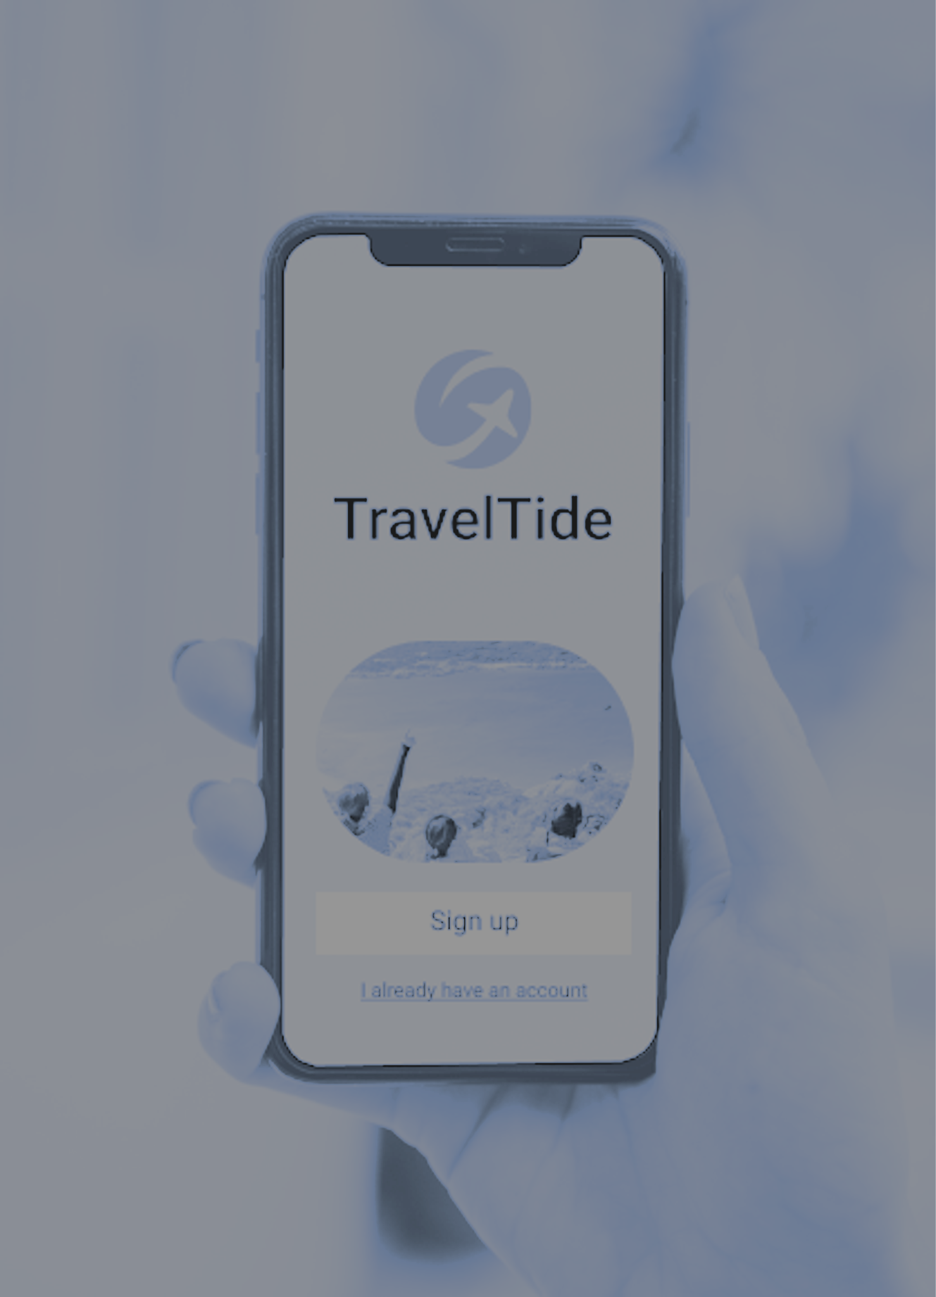
Customer segmentation for perk allocation in TravelTide upcoming loyalty program

Slide 2
Outlines
Define the objectives
Describe the methodology
Show segmentation result
Describe unique features of segments for perk
Conclusion and Recommendation

Slide 3
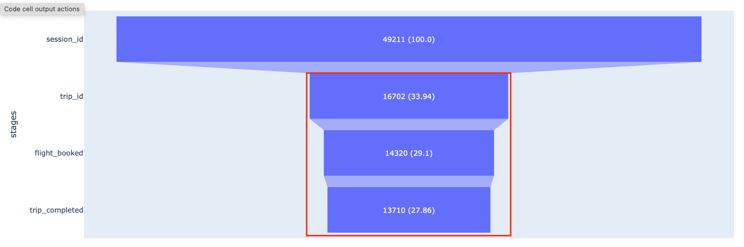
Project Overview
Objectives:
To segment customers based on the personal and trip purchase behaviours.
To allocate an appropriate perk for each segment to ensure their loyalty to TravelTide
Trip-based funnel

Slide 4
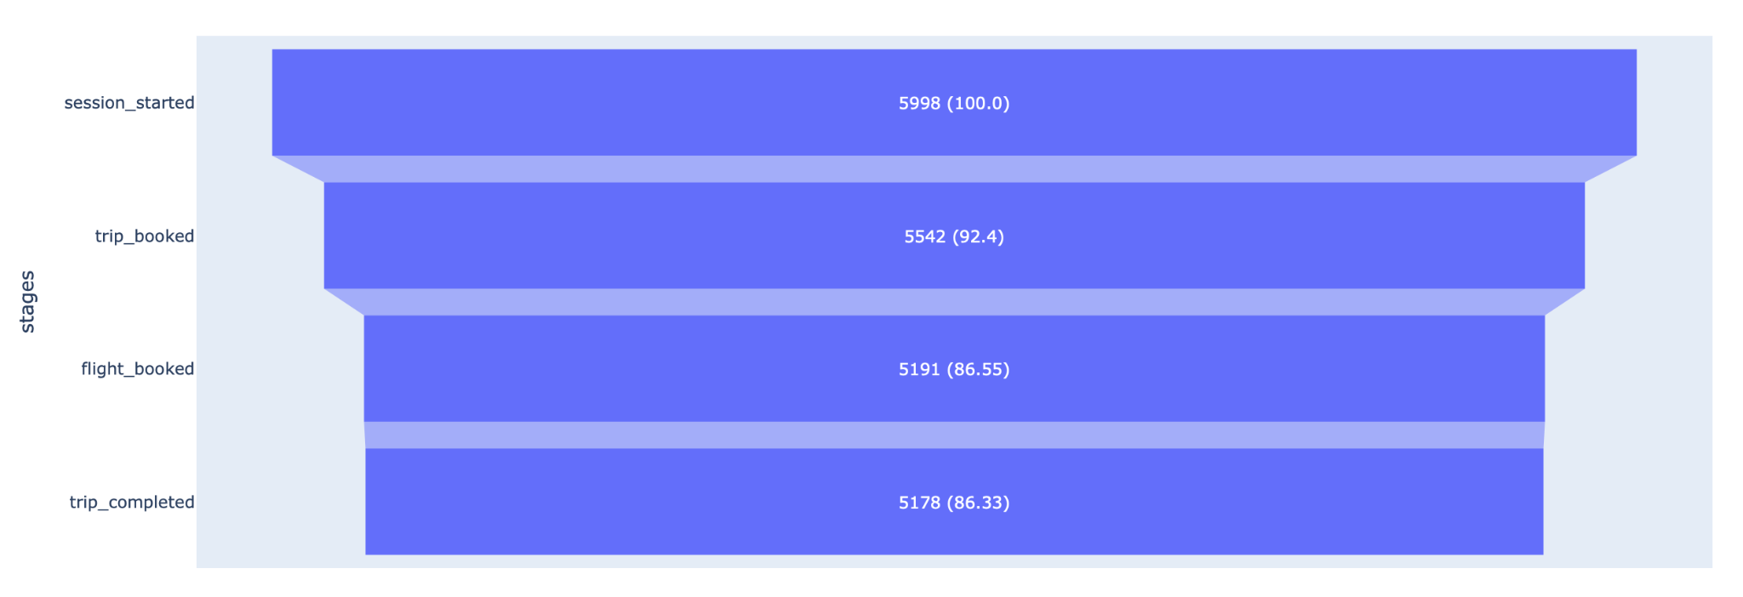
Methodology
Selected a data cohort
Clean data
Develop metrics for segmenting
Scale data , reduce dimensions
Clustering by Gaussian Mixture
Describe segments based on rules
Assign perk
Customers-level funnel

Slide 5
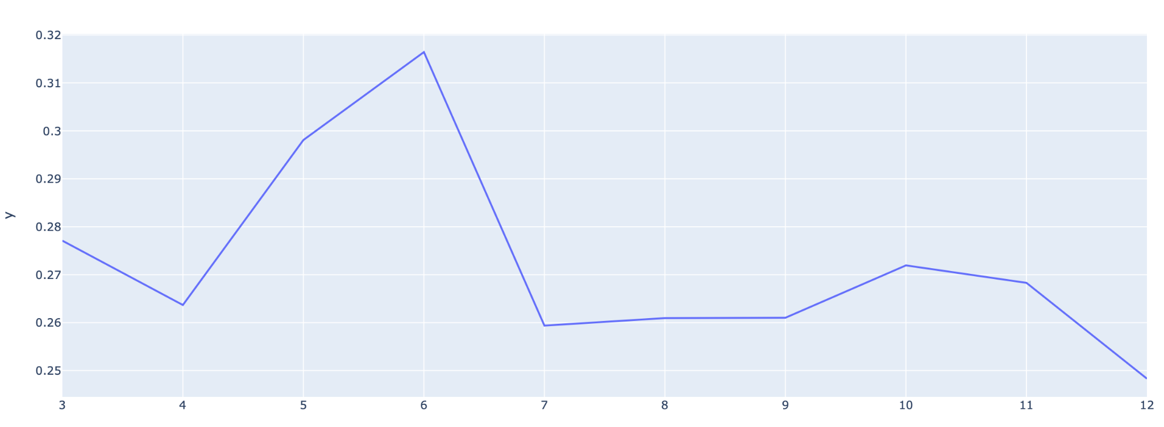
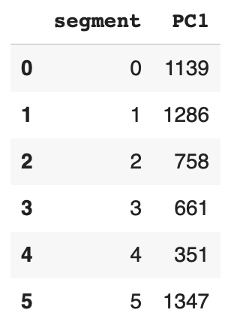
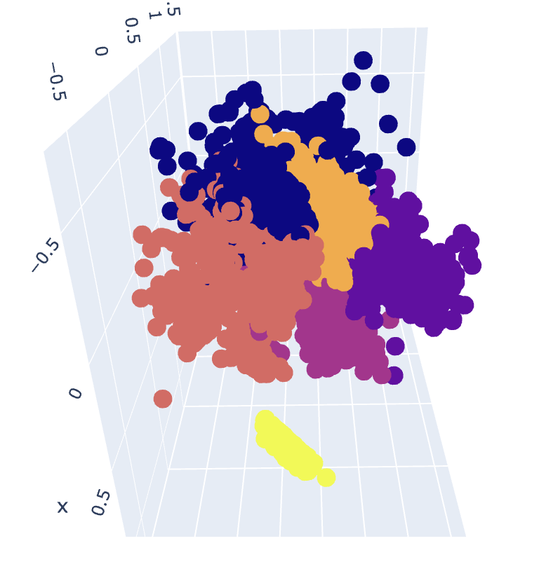
Segmentation Results
silhouette_score
Silhouette score gave the maximum similarity with 6 clusters

Slide 6
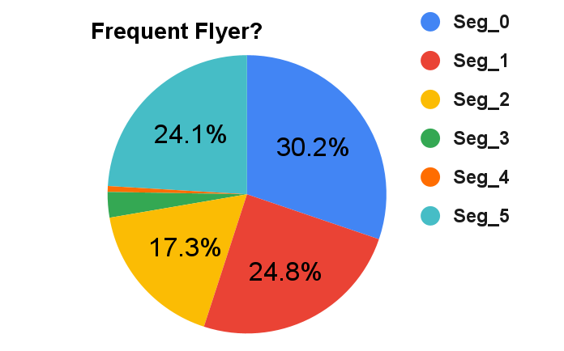
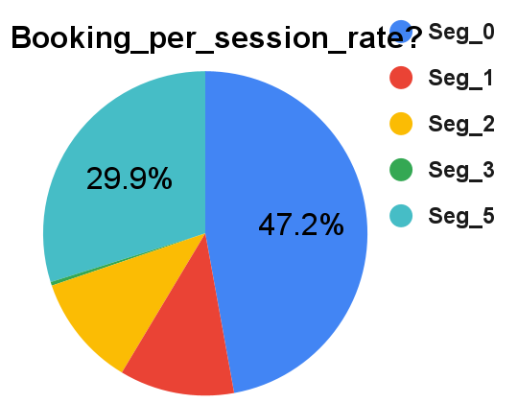
Segment_0
Frequently flying users
Highest booking/session rate
Perk: Free access to airline lounge

Slide 7
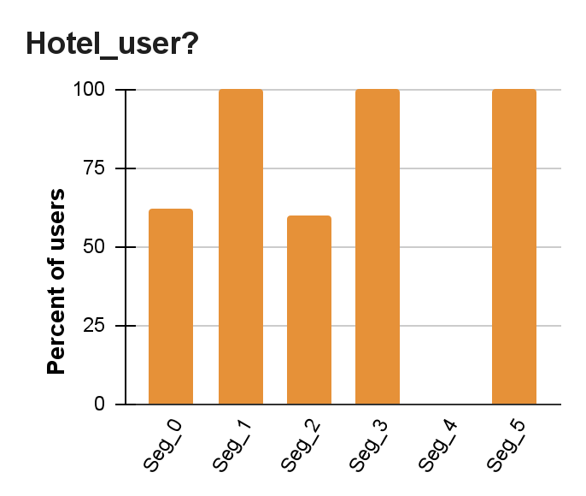
Segment_1
Frequent flyer
100% hotel users
Perk: Free hotel night

Slide 8
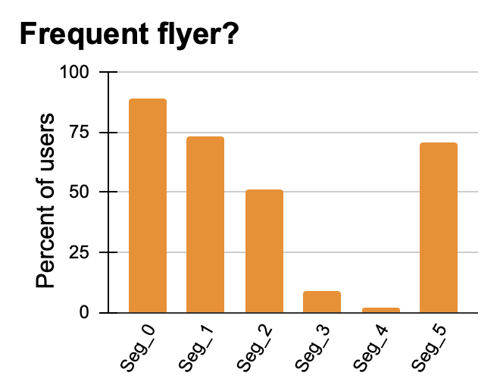
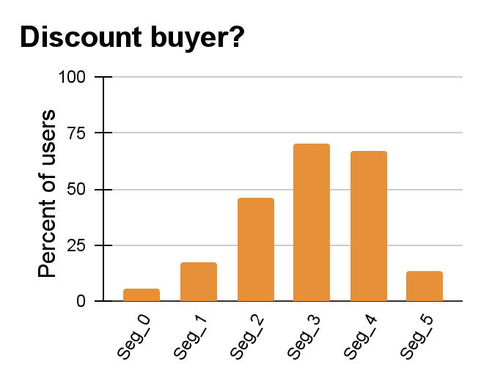
Segment_2
Perk: 10% flight discount

Slide 9
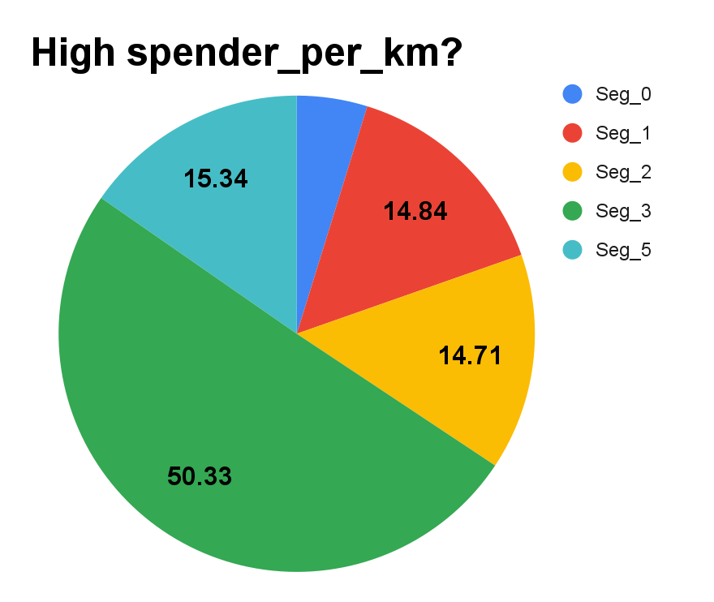
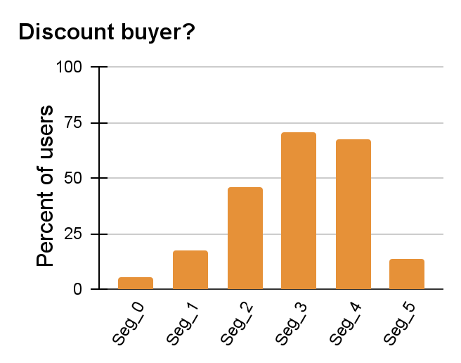
Segment_3
High spenders per km.
Respond to discounts
Perk: 10% Hotel discount

Slide 10
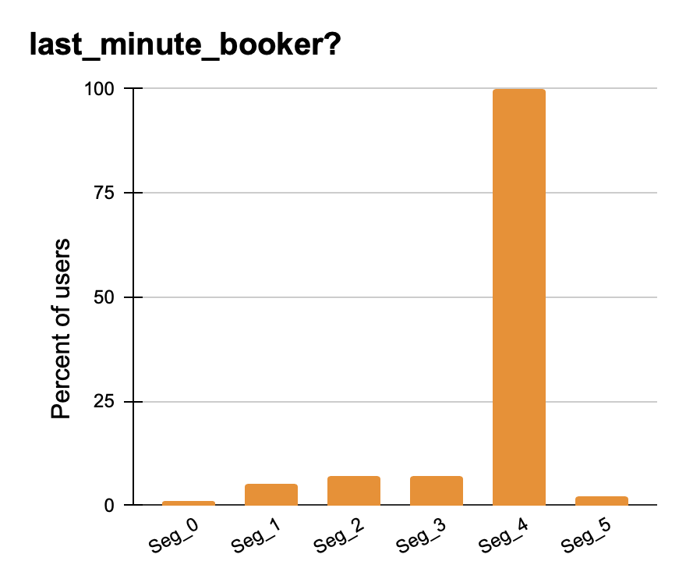
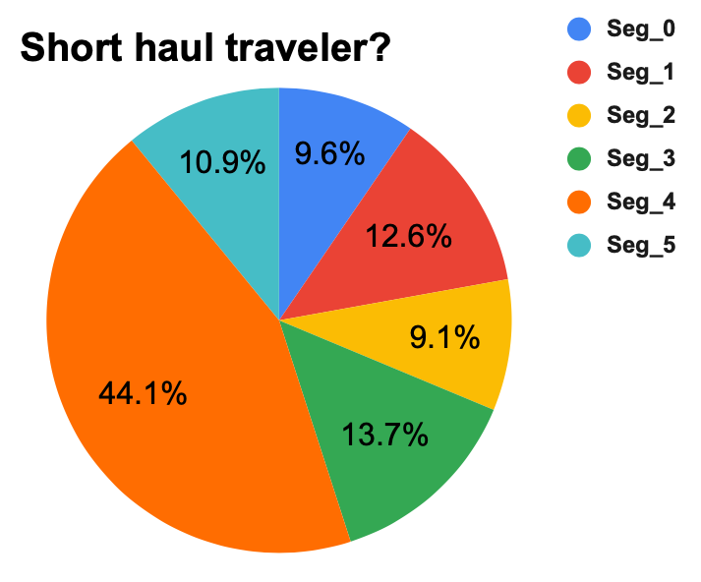
Segment_4
Short haul travelers
Respond to discount
Last-minute booker
Perk: 5% flight discount

Slide 11
Segment_5
More older customers in this segment.
Frequent flyer
Perk: Free ride and hotel meal

Slide 12
Conclusion and Recommendation
The GM algorithm successfully segmented users
Users were nicely splitted into six segments
Three of the 5 Elena’s perk suggestions could be verified by the data.
Reducing the stringency of the cohort selection in terms of session numbers and timeframe may help to identify more customer behaviours and perk allocation.

